Slide 1
INFORMATION SYSTEMS SECURITY, CONTROL AND AUDIT
Information Systems Security
CRYPTOGRAPHY, NETWORKS AND TELECOMMUNICATIONS
Week 9

Slide 2
Objectives
Definition of Cryptography
Cryptography’s Role in Information Security
Business and Security Requirements for Cryptography
Cryptographic Applications and Uses
Cryptographic Functions and Ciphers
Symmetric and Asymmetric Key Cryptography
Digital Signatures and Nonrepudiation
Principles of Certificates and Key Management
The Open Systems Interconnection Reference Model

Slide 3
Objectives
WAN & LAN Networks
TCP/IP and How it Works
Network Security Risks
Basic Network Security Defense Tools

Slide 4
Introduction
Multilevel approach to information security
  Firewalls
  Network intrusion detection systems
  All-in-one network security appliances
Second level of protection
  Encryption of document contents

Slide 5

Defining Cryptography
What is cryptography?
  Scrambling information so it appears unreadable to attackers
  Transforms information into secure form
Stenography
  Hides the existence of data
  Image, audio, or video files containing hidden message embedded in the file
  Achieved by dividing data and hiding in unused portions of the file

Slide 6
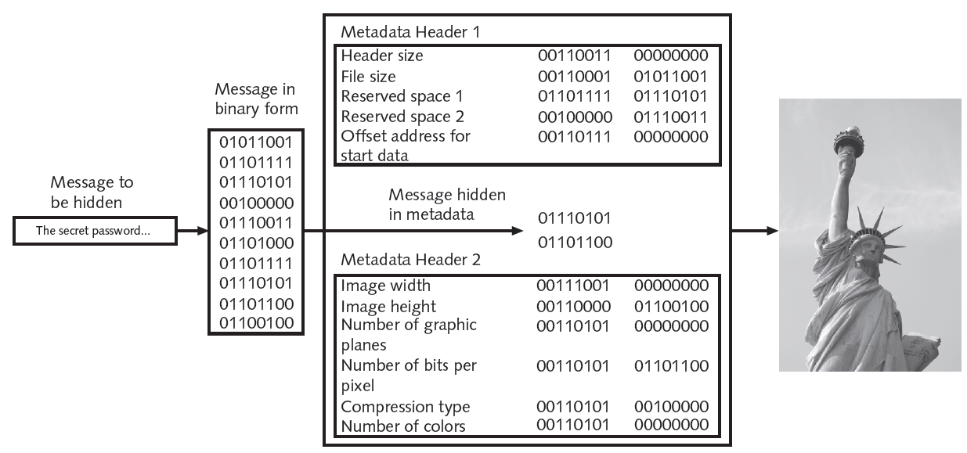
Figure 11-1 Data hidden by stenography

Slide 7
What is Cryptography? (cont’d.)
Origins of cryptography
  Used by Julius Caesar
Encryption
  Changing original text into a secret message using cryptography
Decryption
  Changing secret message back to original form
Cleartext data
  Data stored or transmitted without encryption

Slide 8
What is Cryptography? (cont’d.)
Plaintext
  Data to be encrypted
  Input into an encryption algorithm
Key
  Mathematical value entered into the algorithm to produce ciphertext (scrambled text)
  Reverse process uses the key to decrypt the message

Slide 9
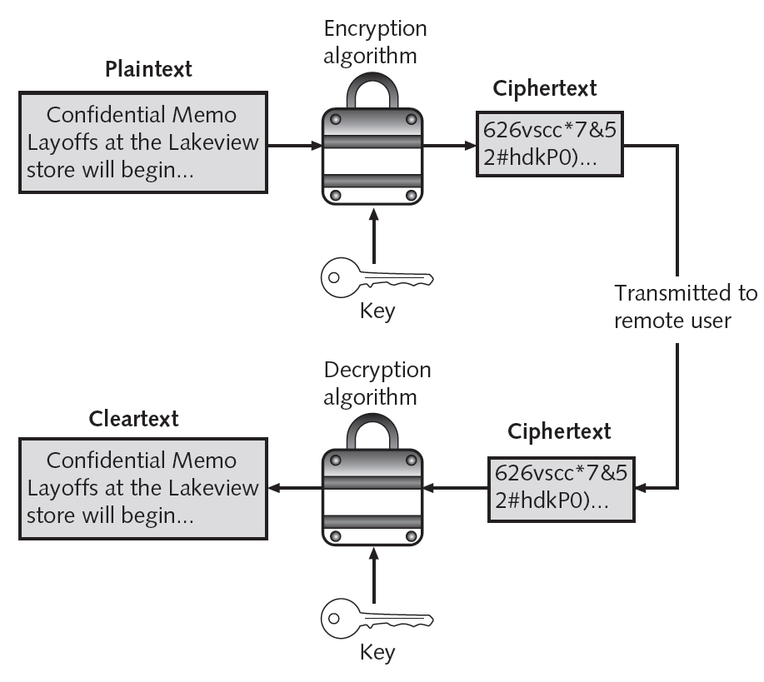
Figure 11-2 Cryptography process

Slide 10
Cryptography and Security
Cryptography can provide five basic information protections
  Confidentiality
    Insures only authorized parties can view it
  Integrity
    Insures information is correct and unaltered
  Availability
    Authorized users can access it
  Authenticity of the sender
  Nonrepudiation
    Proves that a user performed an action

Slide 11
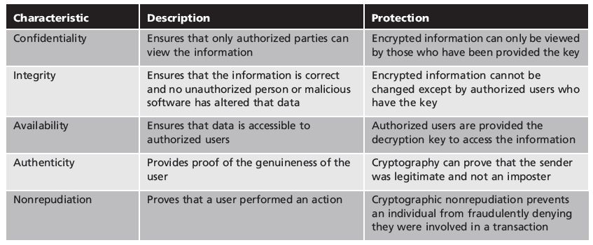
Table 11-1 Information protections by cryptography

Slide 12

Cryptographic Algorithms
Three categories of cryptographic algorithms
  Hash algorithms
  Symmetric encryption algorithms
  Asymmetric encryption algorithms
Hash algorithms
  Most basic type of cryptographic algorithm
  Process for creating a unique digital fingerprint for a set of data
  Contents cannot be used to reveal original data set
  Primarily used for comparison purposes

Slide 13
Cryptographic Algorithms (cont’d.)
Example of hashing (ATMs)
  Bank customer has PIN of 93542
  Number is hashed and result stored on card’s magnetic stripe
  User inserts card in ATM and enters PIN
  ATM hashes the pin using the same algorithm that was used to store PIN on the card
  If two values match, user may access ATM

Slide 14
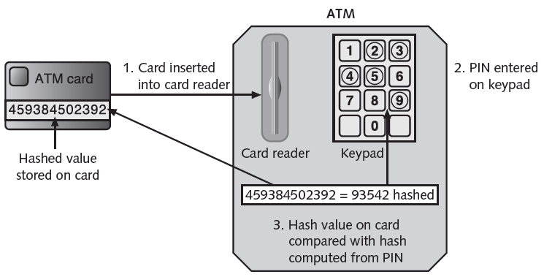
Figure 11-3 Hashing at an ATM
© Cengage Learning 2012

Slide 15
Cryptographic Algorithms (cont’d.)
Secure hashing algorithm characteristics
  Fixed size
    Short and long data sets have the same size hash
  Unique
    Two different data sets cannot produce the same hash
  Original
    Dataset cannot be created to have a predefined hash
  Secure
    Resulting hash cannot be reversed to determine original plaintext

Slide 16
Cryptographic Algorithms (cont’d.)
Hashing used to determine message integrity
  Can protect against man-in-the-middle attacks
Hashed Message Authentication Code (HMAC)
  Hash variation providing improved security
  Uses secret key possessed by sender and receiver
  Receiver uses key to decrypt the hash
Hash values often posted on download sites
  To verify file integrity after download

Slide 17
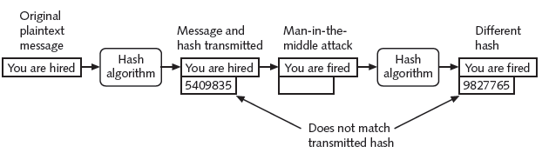
Figure 11-4 Man-in-the-middle attack defeated by hashing

Slide 18
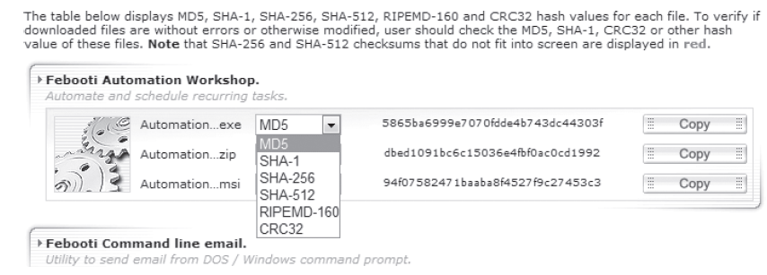
Figure 11-5 Posted hash values

Slide 19
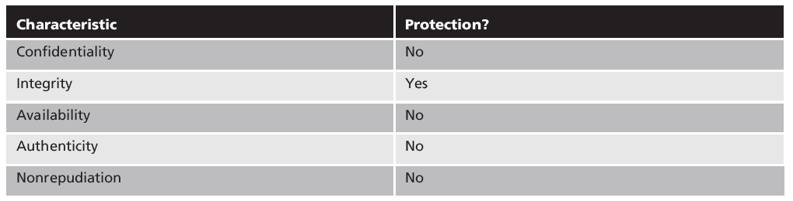
Table 11-2 Information protections by hashing cryptography
© Cengage Learning 2012

Slide 20
Cryptographic Algorithms (cont’d.)
Most common hash algorithms
  Message Digest
  Secure Hash Algorithm
  Whirlpool
  RIPEMD
  Password hashes

Slide 21
Cryptographic Algorithms (cont’d.)
Message Digest (MD)
  Three versions
Message Digest 2
  Takes plaintext of any length and creates 128 bit hash
  Padding added to make short messages 128 bits
  Considered too slow today and rarely used
Message Digest 4
  Has flaws and was not widely accepted

Slide 22
Cryptographic Algorithms (cont’d.)
Message Digest 5
  Designed to address MD4’s weaknesses
  Message length padded to 512 bits
  Weaknesses in compression function could lead to collisions
  Some security experts recommend using a more secure hash algorithm
Secure Hash Algorithm (SHA)
  More secure than MD
  No weaknesses identified

Slide 23
Cryptographic Algorithms (cont’d.)
Whirlpool
  Recent cryptographic hash
  Adopted by standards organizations
  Creates hash of 512 bits
Race Integrity Primitives Evaluation Message Digest (RIPEMD)
  Two different and parallel chains of computation
  Results are combined at end of process

Slide 24
Cryptographic Algorithms (cont’d.)
Password hashes
  Used by Microsoft Windows operating systems
    LAN Manager hash
    New Technology LAN Manager (NTLM) hash
Linux and Apple Mac strengthen password hashes by including random bit sequences
  Known as a salt
  Make password attacks more difficult

Slide 25
Symmetric Cryptographic Algorithms
Original cryptographic algorithms
Data Encryption Standard
Triple Data Encryption Standard
Advanced Encryption Standard
Several other algorithms
Understanding symmetric algorithms
  Same shared single key used to encrypt and decrypt document

Slide 26
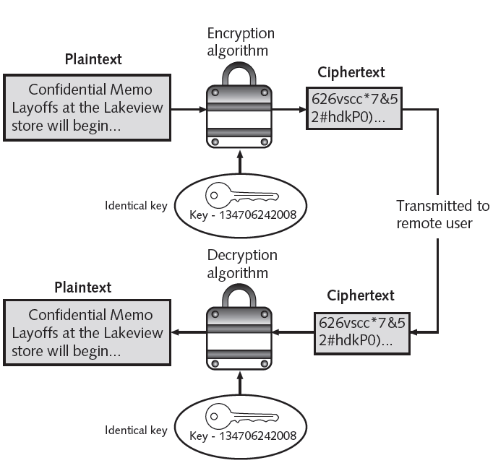
Figure 11-6 Symmetric (private key) cryptography

Slide 27
Symmetric Cryptographic Algorithms (cont’d.)
Two symmetric algorithm categories
  Based on amount of data processed at a time
Stream cipher
  Takes a character and replaces it with a character
  Simplest type: substitution cipher
Mono-alphabetic substitution cipher
  Easy to break

Slide 28
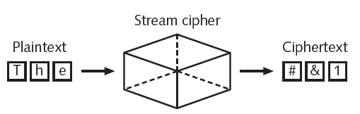
Figure 11-7 Stream cipher
© Cengage Learning 2012

Slide 29
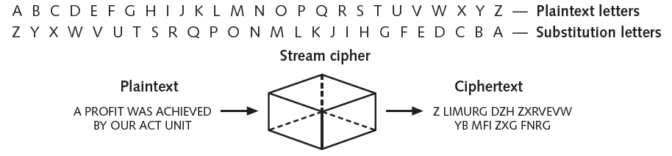
Symmetric Cryptographic Algorithms (cont’d.)
Homoalphabetic substitution cipher
  Single plaintext character mapped to multiple ciphertext character
Figure 11-8 Substitution cipher

Slide 30

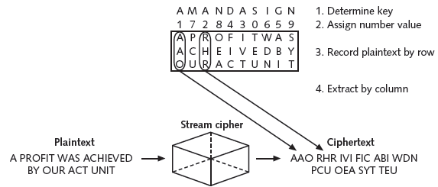
Symmetric Cryptographic Algorithms (cont’d.)
Transposition cipher
  Rearranges letters without changing them
Figure 11-9 Transposition cipher

Slide 31
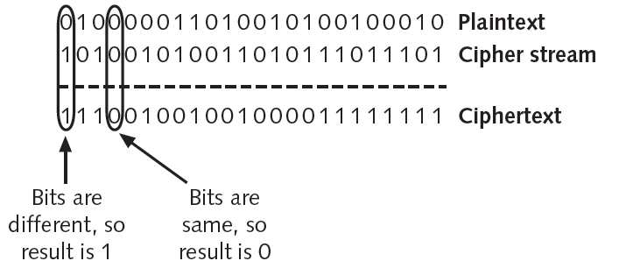
Symmetric Cryptographic Algorithms (cont’d.)
Final step in most symmetric ciphers
  Combine cipher stream with plaintext to create the ciphertext
Figure 11-10 Combine ciphertext

Slide 32
Symmetric Cryptographic Algorithms (cont’d.)
One-time pad (OTP)
  Creates a truly random key to combine with the plaintext
  Considered secure if random, kept secret, and not reused
Block cipher
  Works on entire block of plaintext at a time
  Separate blocks of 8 to 16 bytes encrypted independently
  Blocks randomized for additional security

Slide 33
Symmetric Cryptographic Algorithms (cont’d.)
Stream cipher advantages
  Fast if plaintext is short
Stream cipher disadvantages
  Consumes much processing power if plaintext is long
  More prone to attack because engine generating stream does not vary
Block ciphers considered more secure because output is more random

Slide 34
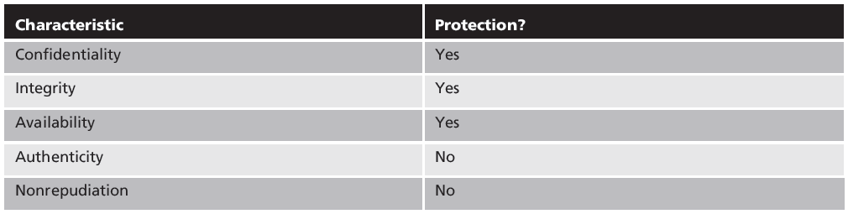
Table 11-3 Information protections by symmetric cryptography

Slide 35
Symmetric Cryptographic Algorithms (cont’d.)
Data Encryption Standard (DES)
  Based on product originally designed in early 1970s
  Adopted as a standard by the U.S. government
Triple Data Encryption standard (3DES)
  Designed to replace DES
  Uses three rounds of encryption
  Ciphertext of first round becomes input for second iteration
  Most secure versions use different keys used for each round

Slide 36
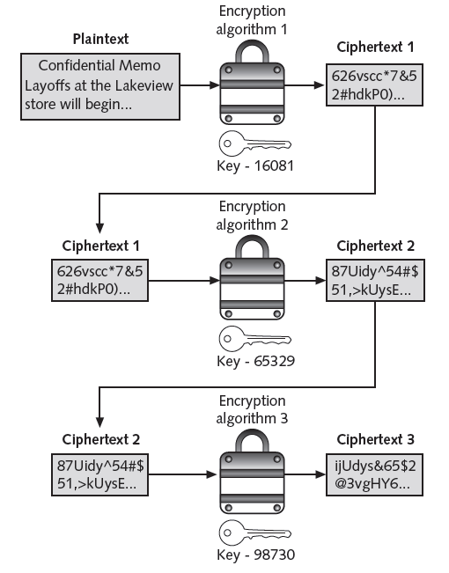
Figure 11-11 3DES

Slide 37
Symmetric Cryptographic Algorithms (cont’d.)
Advanced Encryption Standard (AES)
  Symmetric cipher approved by NIST in 2000 as replacement for DES
  Official encryption standard used by the U.S. government
  Performs three steps on every block of plaintext
  Designed to be secure well into the future

Slide 38
Other Algorithms
Rivest Cipher (RC)
  Family of cipher algorithms designed by Ron Rivest
International Data Encryption Algorithm (IDEA)
  Used in European nations
  Block cipher processing 64 bits with a 128-bit key with 8 rounds
Blowfish
  Block cipher operating on 64-bit blocks with key lengths from 32-448 bits
  No significant weaknesses have been identified

Slide 39
Asymmetric Cryptographic Algorithms
Weakness of symmetric algorithms
  Distributing and maintaining a secure single key among multiple users distributed geographically
Asymmetric cryptographic algorithms
  Also known as public key cryptography
  Uses two mathematically related keys
  Public key available to everyone and freely distributed
  Private key known only to individual to whom it belongs

Slide 40
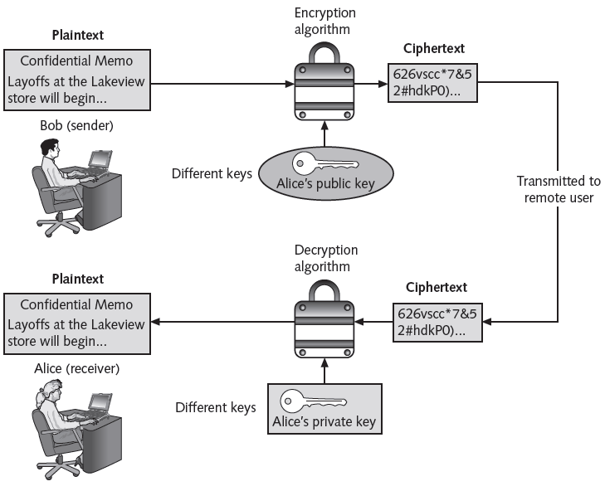
Figure 11-12 Asymmetric (public key) cryptography

Slide 41

Asymmetric Cryptographic Algorithms (cont’d.)
Important principles
  Key pairs
  Public key
  Private key
  Both directions
Digital signature
  Verifies the sender
  Prevents sender from disowning the message
  Proves message integrity

Slide 42
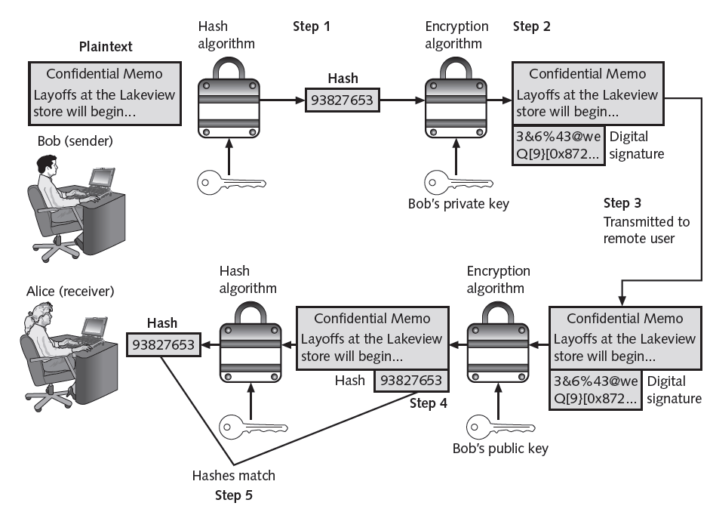
Figure 11-13 Digital signature

Slide 43
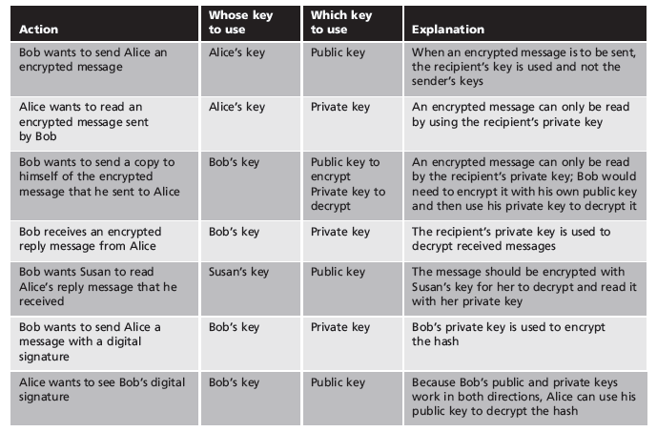
Table 11-4 Asymmetric cryptography practices

Slide 44
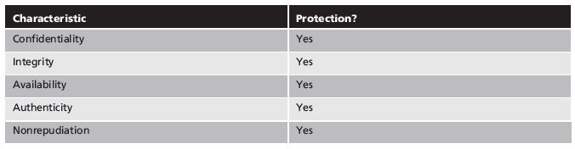
Table 11-5 Information protections by asymmetric cryptography

Slide 45
Asymmetric Cryptographic Algorithms (cont’d.)
RSA
  Published in 1977 and patented by MIT in 1983
  Most common asymmetric cryptography algorithm
  Uses two large prime numbers
Elliptic curve cryptography (ECC)
  Users share one elliptic curve and one point on the curve
  Uses less computing power than prime number-based asymmetric cryptography
    Key sizes are smaller

Slide 46
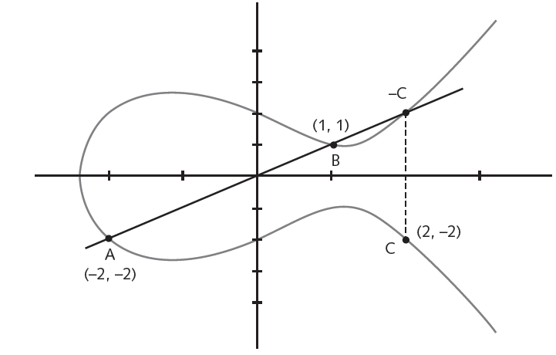
Figure 11-14 Elliptic curve cryptography (ECC)

Slide 47
Asymmetric Cryptographic Algorithms (cont’d.)
Quantum cryptography
  Exploits the properties of microscopic objects such as photons
  Does not depend on difficult mathematical problems
NTRUEncypt
  Uses lattice-based cryptography
  Relies on a set of points in space
  Faster than RSA and ECC
  More resistant to quantum computing attacks

Slide 48
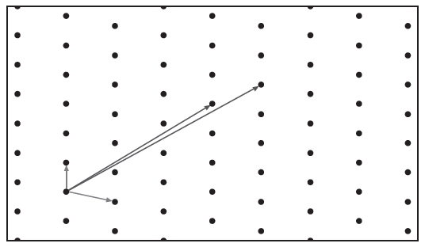
Figure 11-15 Lattice-based cryptography

Slide 49
Using Cryptography
Cryptography
  Should be used to secure data that needs to be protected
  Can be applied through either software or hardware

Slide 50
Encryption Through Software
File and file system cryptography
  Encryption software can be applied to one or many files
Protecting groups of files
  Based on operating system’s file system
Pretty Good Privacy (PGP)
  Widely used asymmetric cryptography system
  Used for files and e-mails on Windows systems
GNU Privacy Guard (GPG)
  Runs on Windows, UNIX, and Linux

Slide 51
Encryption Through Software (cont’d.)
PGP and GPG use both asymmetric and symmetric cryptography
Microsoft Windows Encrypting File System (EFS)
  Cryptography system for Windows
  Uses NTFS file system
  Tightly integrated with the file system
  Encryption and decryption transparent to the user
  Users can set encryption attribute for a file in the Advanced Attributes dialog box

Slide 52
Encryption Through Software (cont’d.)
Whole disk encryption
  Protects all data on a hard drive
  Example: BitLocker drive encryption software

Slide 53
Hardware Encryption
Software encryption can be subject to attacks to exploit its vulnerabilities
Cryptography can be embedded in hardware
  Provides higher degree of security
  Can be applied to USB devices and standard hard drives
  Trusted platform module
  Hardware security model

Slide 54
Hardware Encryption (cont’d.)
USB device encryption
Encrypted hardware-based flash drives
  Will not connect a computer until correct password has been provided
  All data copied to the drive is automatically encrypted
  Tamper-resistant external cases
  Administrators can remotely control and track activity on the devices
  Stolen drives can be remotely disabled

Slide 55
Hardware Encryption (cont’d.)
Hard disk drive encryption
  Self-encrypting hard disk drives protect all files stored on them
  Drive and host device perform authentication process during initial power up
  If authentication fails, drive can be configured to deny access or even delete encryption keys so all data is permanently unreadable

Slide 56
Hardware Encryption (cont’d.)
Trusted Platform Module (TPM)
  Chip on computer’s motherboard that provides cryptographic services
  Includes a true random number generator
  Entirely done in hardware so cannot be subject to software attack
  Prevents computer from booting if files or data have been altered
  Prompts for password if hard drive moved to a new computer

Slide 57
Hardware Encryption (cont’d.)
Hardware Security Module (HSM)
  Secure cryptographic processor
  Includes onboard key generator and key storage facility
  Performs accelerated symmetric and asymmetric encryption
  Can provide services to multiple devices over a LAN

Slide 58
Summary
Cryptography is science of transforming information into a secure form while being transmitted or stored
Hashing creates a unique digital fingerprint that represents contents of original material
  Used only for comparison
Symmetric cryptography uses a single key to encrypt and decrypt a message
  Stream ciphers and block ciphers

Slide 59
Summary (cont’d.)
Asymmetric cryptography
  Public key cryptography
  Uses two keys: public key and private key
  Can be used to create a digital signature
Cryptography can be applied through hardware or software
Hardware encryption cannot be exploited like software cryptography

Slide 60
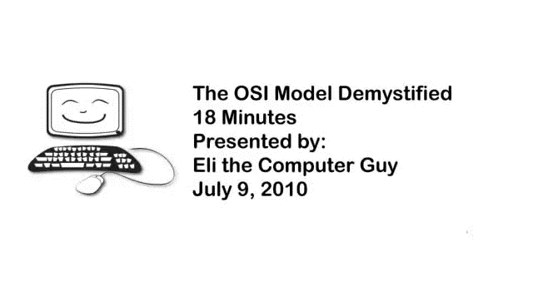
OSI MODEL DEMYSTIFIED

Slide 61
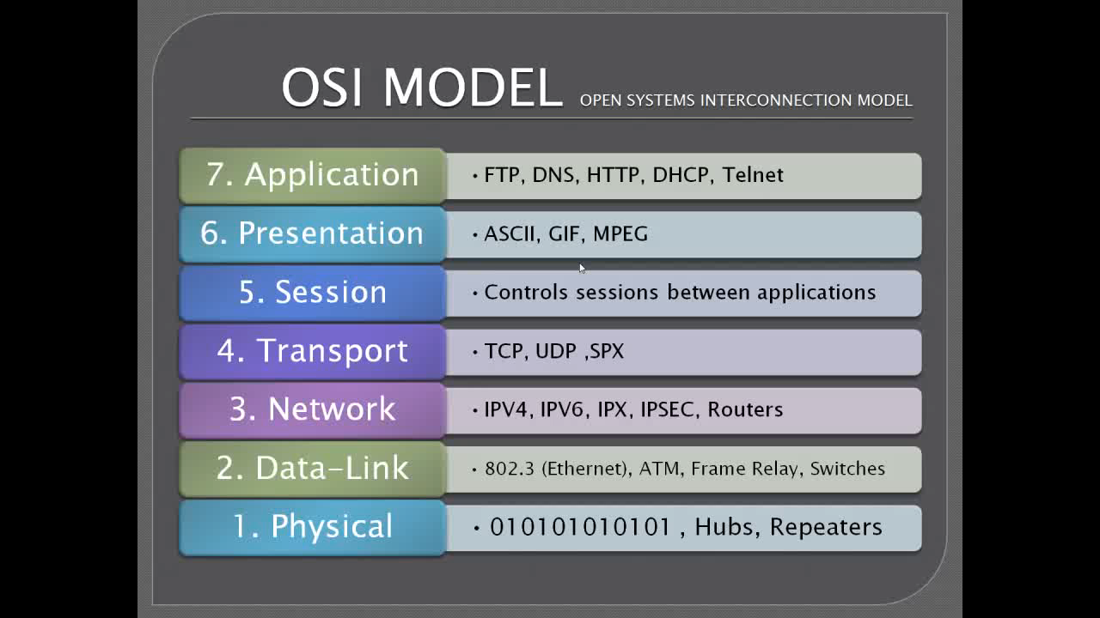
OSI MODEL DEMYSTIFIED

